Slide 1
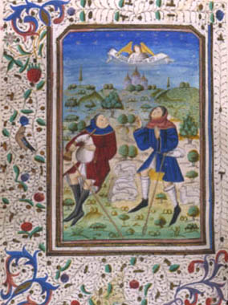
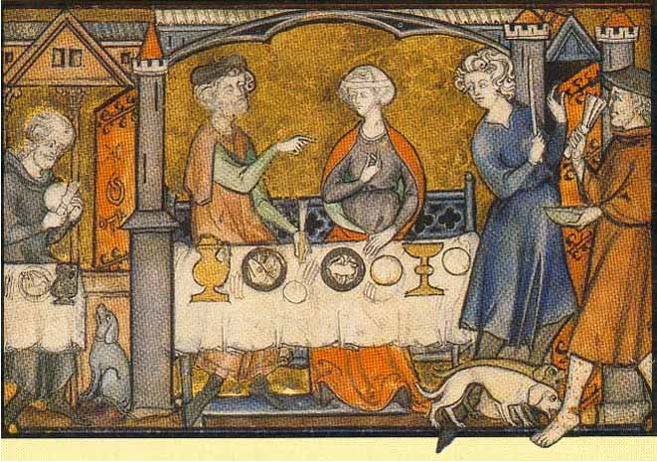
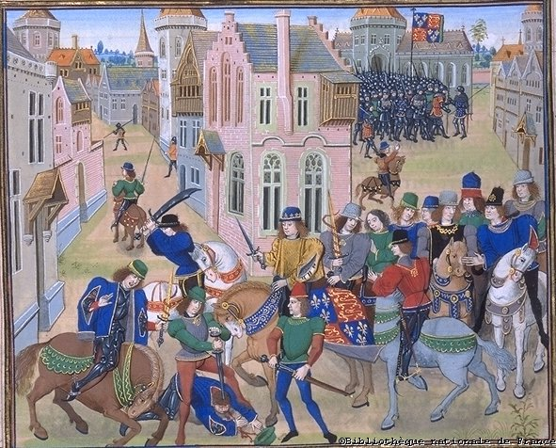
The Rise of Europe: The Early Middle Ages – Part 1
Early Middle Ages Packet: Numbers 1 through 34

Slide 2
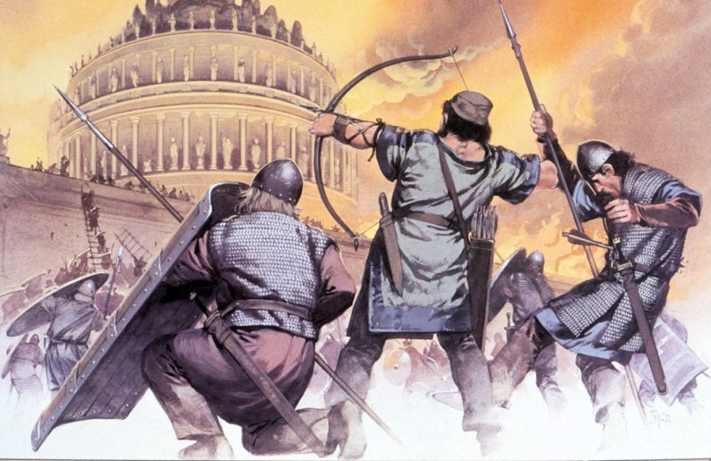
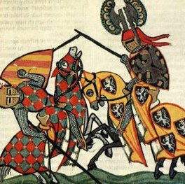
Western Europe in Decline
Why the Dark Ages?
Europe entered period of economic, political and social decline after fall of the Roman Empire
500 – 1000 AD politically divided, rural, cut off from other advanced civilizations in Middle East, China and India.
Learning & trade basically ceased.
Invaders swept across the land.
This culture / medieval civilization from Latin word for Middle Ages

Slide 3
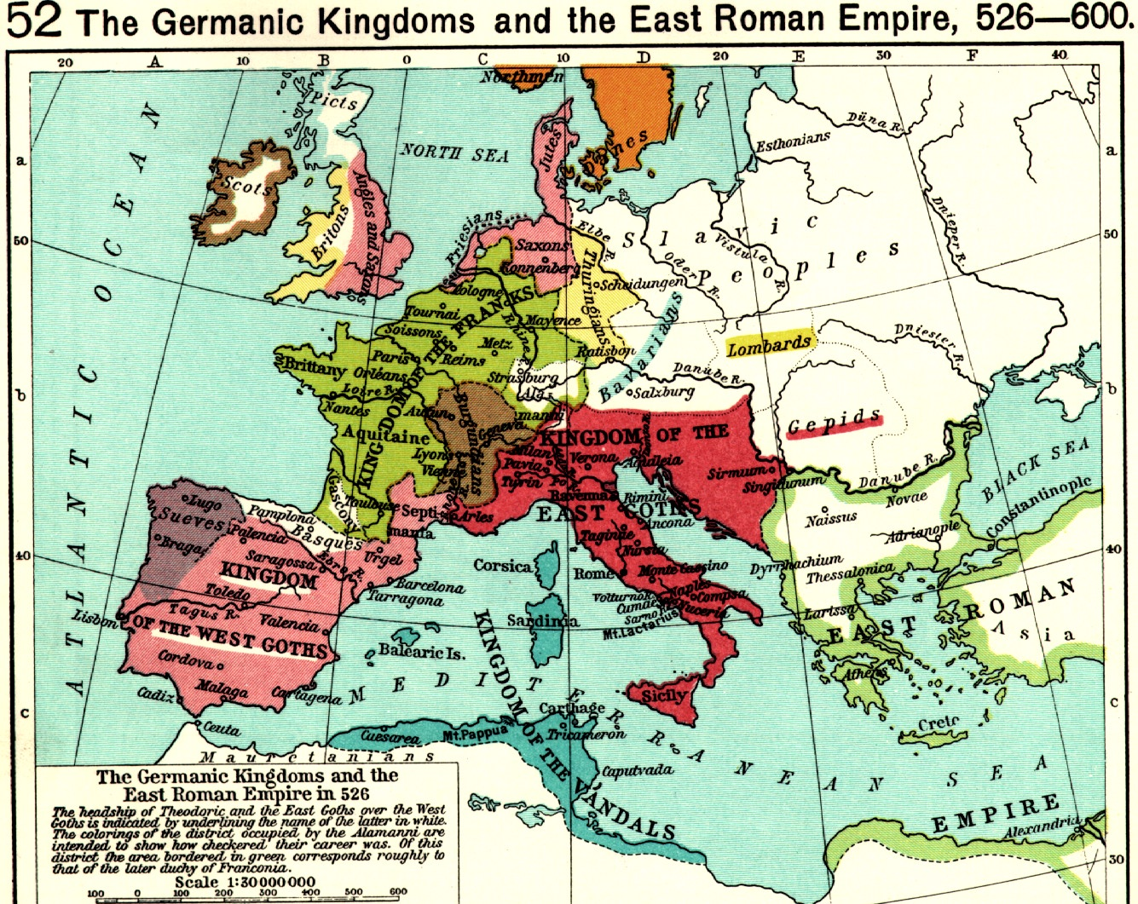
After the Fall of the Western Roman Empire Germanic Kingdoms took control of Europe from 400 – 700 AD. The Frankish Kingdoms being the most long lasting.

Slide 4
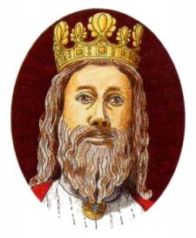
486, Clovis, king of Franks, conquered former province of Gaul (now France.)
Clovis converted to Christianity, religion of his subjects.
Gained powerful ally in the Pope, leader of Christian Church in Rome
Because of a lack of a central government, the church played an important role and Christianity spread throughout Europe

Slide 5
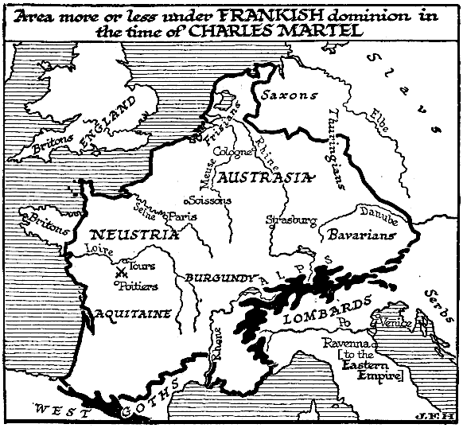
CAROLIGNIAN
EMPIRE
732 Charles Martel rallied Frankish warriors - defeated Muslim invaders at the Battle of Tours –became great Christian Victory
Victory was a “sign that God was on their side.”
Muslims continued to try & force Islam into Western Europe.

Slide 6
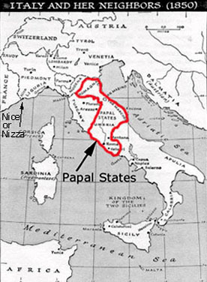
CAROLIGNIAN EMPIRE
In 756, Charles Martel’s son Pepin defeated the Lombards in central Italy & donated the captured land to the Pope –
creating the PAPAL STATES –
called THE DONATION OF PEPIN

Slide 7
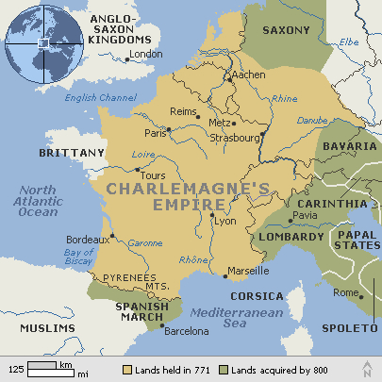
By authority of the Church, I, Pope Leo, crown thee Holy Roman Emperor
Germanic People-
Clovis converted to Christianity in 481
God Himself has made me King
Christmas
Day
800 AD
Created large empire of self-sufficient manors controlled by Counts – unified the Empire under his ultimate control
Carolingian Renaissance – Revival of Education (see bottom right corner)
Brutally put down a Saxon Revolt
Kingdom divided into 3 parts by his grandsons after his death in 814 - weakened Empire’s unity caused collapse of Kingdom
Prevented Muslims from expanding into Europe
Charlemagne established schools in monasteries bringing a Revival of Education - Carolingian Renaissance
Converted Germanic people to Christianity through warfare - unified the people

Slide 8
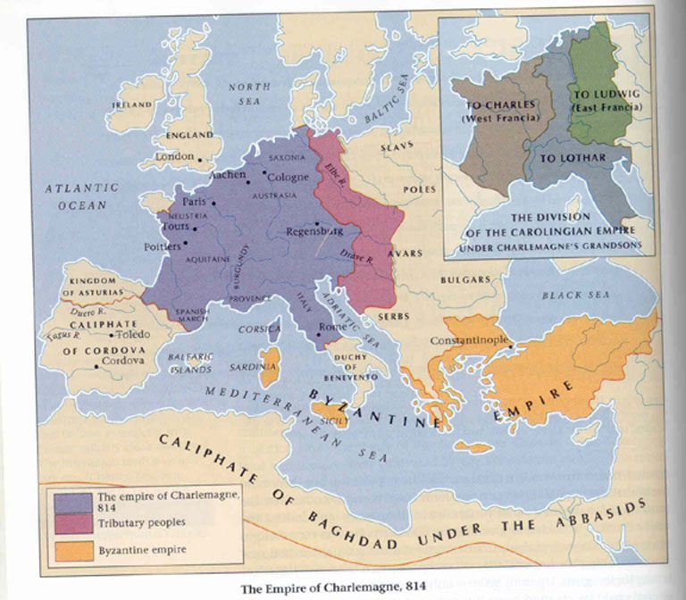
After years of fighting, Charlemagne’s grandsons, under the TREATY OF VERDUN divided CHARLEMAGNE’S empire into 3 separate parts- and the Frankish Kingdoms fell to invaders
Following division of the Empire – Europe was invaded for two centuries by non-Christian invaders –
The Muslims from the south, the Magyars from the east, and the Vikings from the north

Slide 9
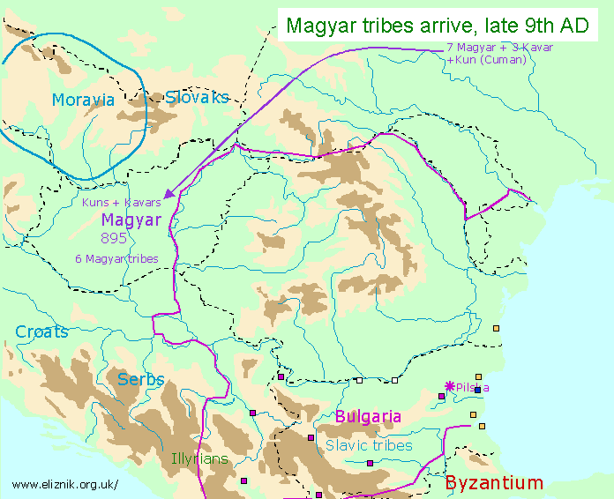
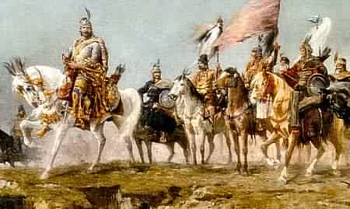
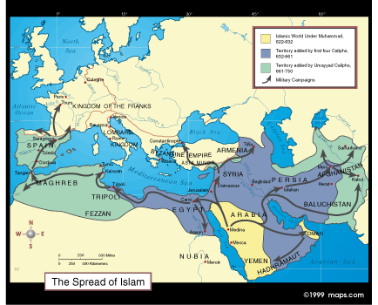
The Magyars attacked isolated settlements and killed or carried everyone off – selling them into slavery.
Many thought they were the Huns returning and begin calling them Hungarians (Hungary today)
The Muslims were biggest challenge to Christian Europe. They came from northern Africa through Spain.
They captured people as slaves and considered Christians their most serious religious rivals

Slide 10
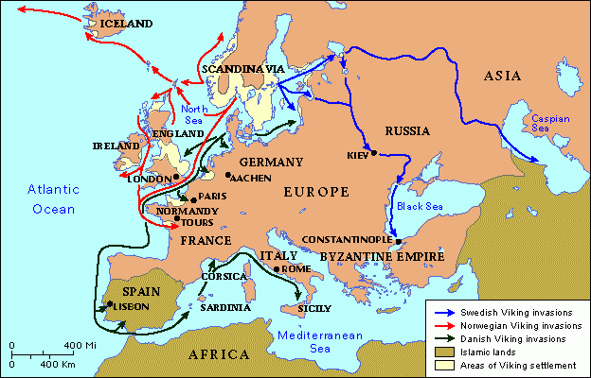
As Vikings settled into Europe, they adopted Christianity – as did the Germanic Tribes
Lifestyle based on Sea VIKING = PIRATE
Tribal Units (Jarl)- Values: culture of war Religion: polytheistic
Two main reasons that the Vikings left their homelands: 1) overpopulation; not enough land 2) ship and weapon improvements; very fast ships that could carry large numbers of warriors
Raided coastal villages throughout Europe
Europe was weak after Charlemagne's Empire fell apart
Danes (from Denmark) attacked France, Germany and England ; the Norwegians (from Norway) attacked Scotland, Ireland and other North Atlantic islands; the Swedes (from Sweden) attacked Russia and the Byzantine Empire
We could stop the Viking raids if we had a strong central government
Viking’s power kept many people in a state of terror
Peasants and artisans looked to local Lords to protect them – this contributed to the development of feudalism

Slide 11
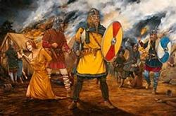
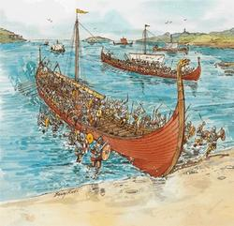
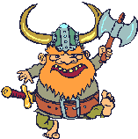
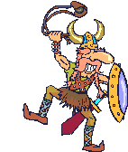
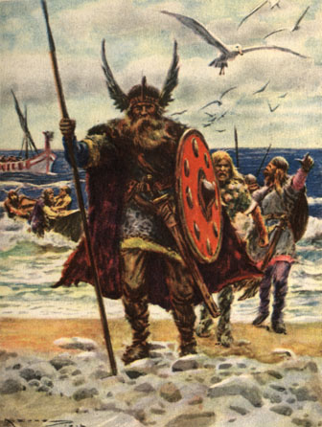
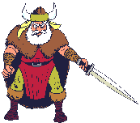
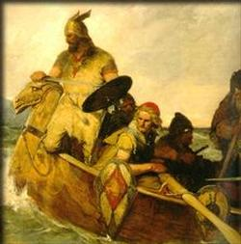
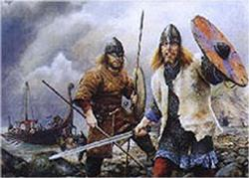
Viking Raids

Slide 12
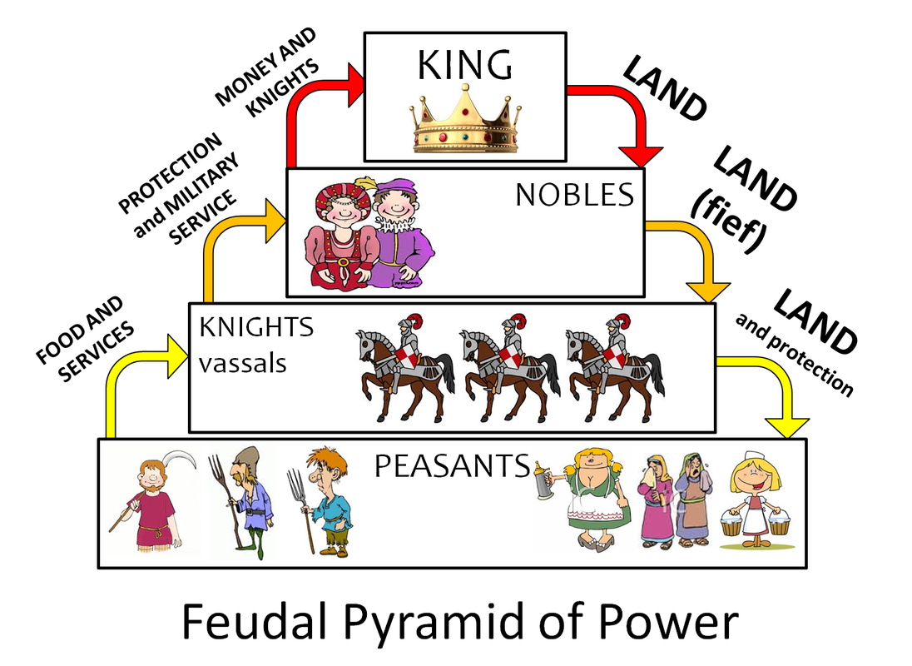
Feudalism and the Manor
The FEUDAL Order
After breakup of Carolingian Empire, Europe was divided into individual territories
Political power was local & passed from generation to generation
aristocrats had a place of power.
Knighthood created to defend feudal powers
In the beginning the king has little or no power -
the nobles had the most power
Serfs are tied to the land
The Manorial System/Feudalism is an economic co-dependency

Slide 13
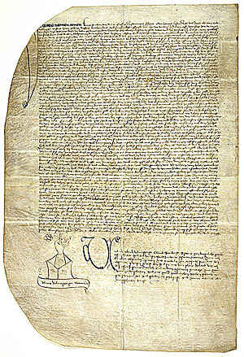
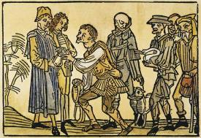
A vassal is anyone who swears loyalty to another in a higher position - the vassal promises goods or service to the lord in exchange for protection or reward
A vassal could be a serf, a knight, even a lord
The
Feudal Contract – An agreement between a vassal and a lord promising goods and/or services

Slide 14
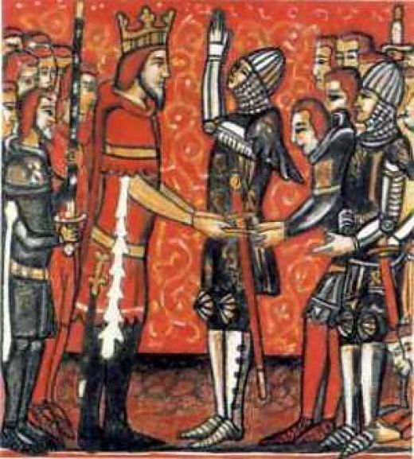
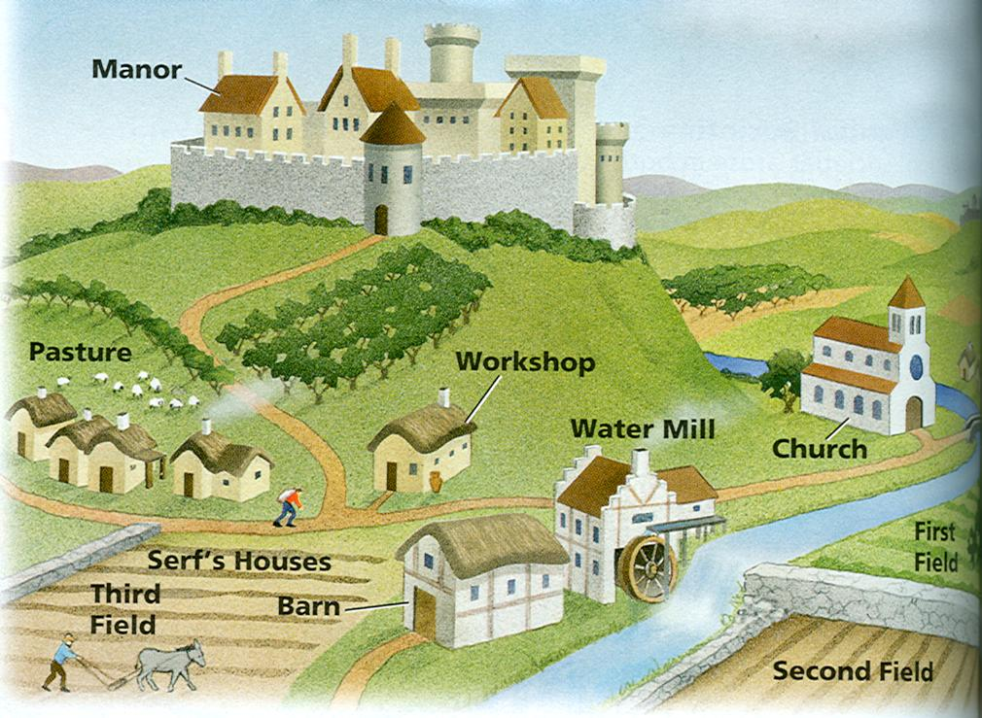
Fief - a large area of land that was ruled over by a lord in medieval times : a landed estate given by a lord to a vassal in return for the vassal's service to the lord. The vassal could use the fief as long as he remained loyal to the lord.
For example: lords would give the knight (vassal) a piece of land (fiefs) and/or money - In return, the knight would fight for his lord

Slide 15
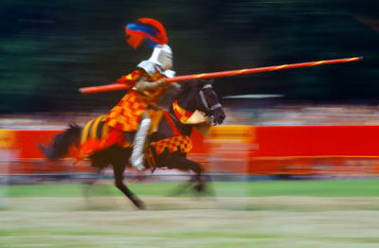
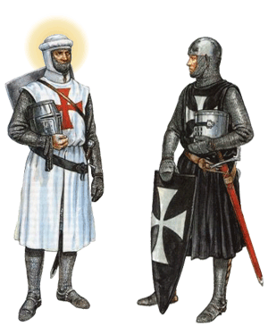
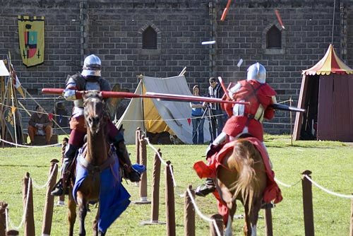
KNIGHTS trained warriors, studied warfare from age of 7.
Wore armor & carried a shield.
Usually fought on horseback.
Followed code of chivalry.
Exchanged military service for fief (land.)
Knights would practice their skills in tournaments.

Slide 16
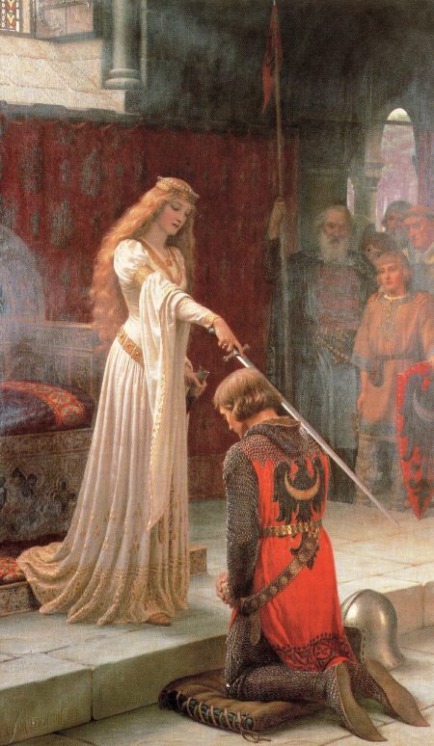
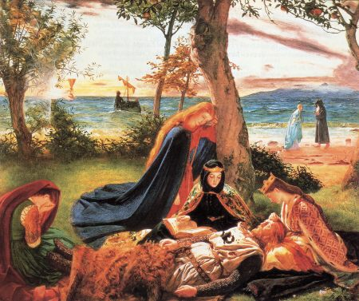
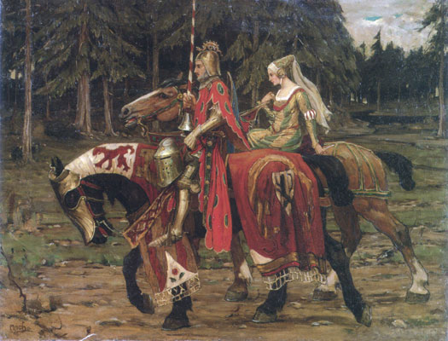
By the 1100s the knights had a code of conduct called CHIVALRY:
Chivalry also introduced the idea of Courtly, or Romantic Love – mostly a thing of fairy tales
Writing love songs and poetry. Acted out by so-called troubadours of the late eleventh century.
Be brave, fair, and protect women, children, and clergy

Slide 17
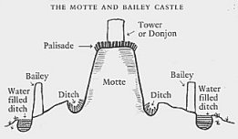
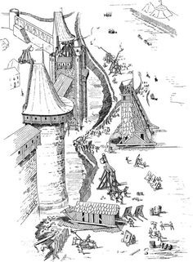
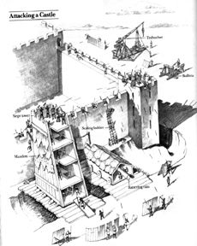
Kitchen and workshops
residence
keep
Inner bailey
parapet
stables
Ventilation slit
drawbridge
stockade
motte
bailey
moat
In the early Middle Ages, the Manor House and village cottages were all made out of wood
Motte and Bailey Castles
drawbridge
moat
13th Century Castles
The idea of “castles” came from crusaders visiting the east – there they saw stronger stone fortifications

Slide 18
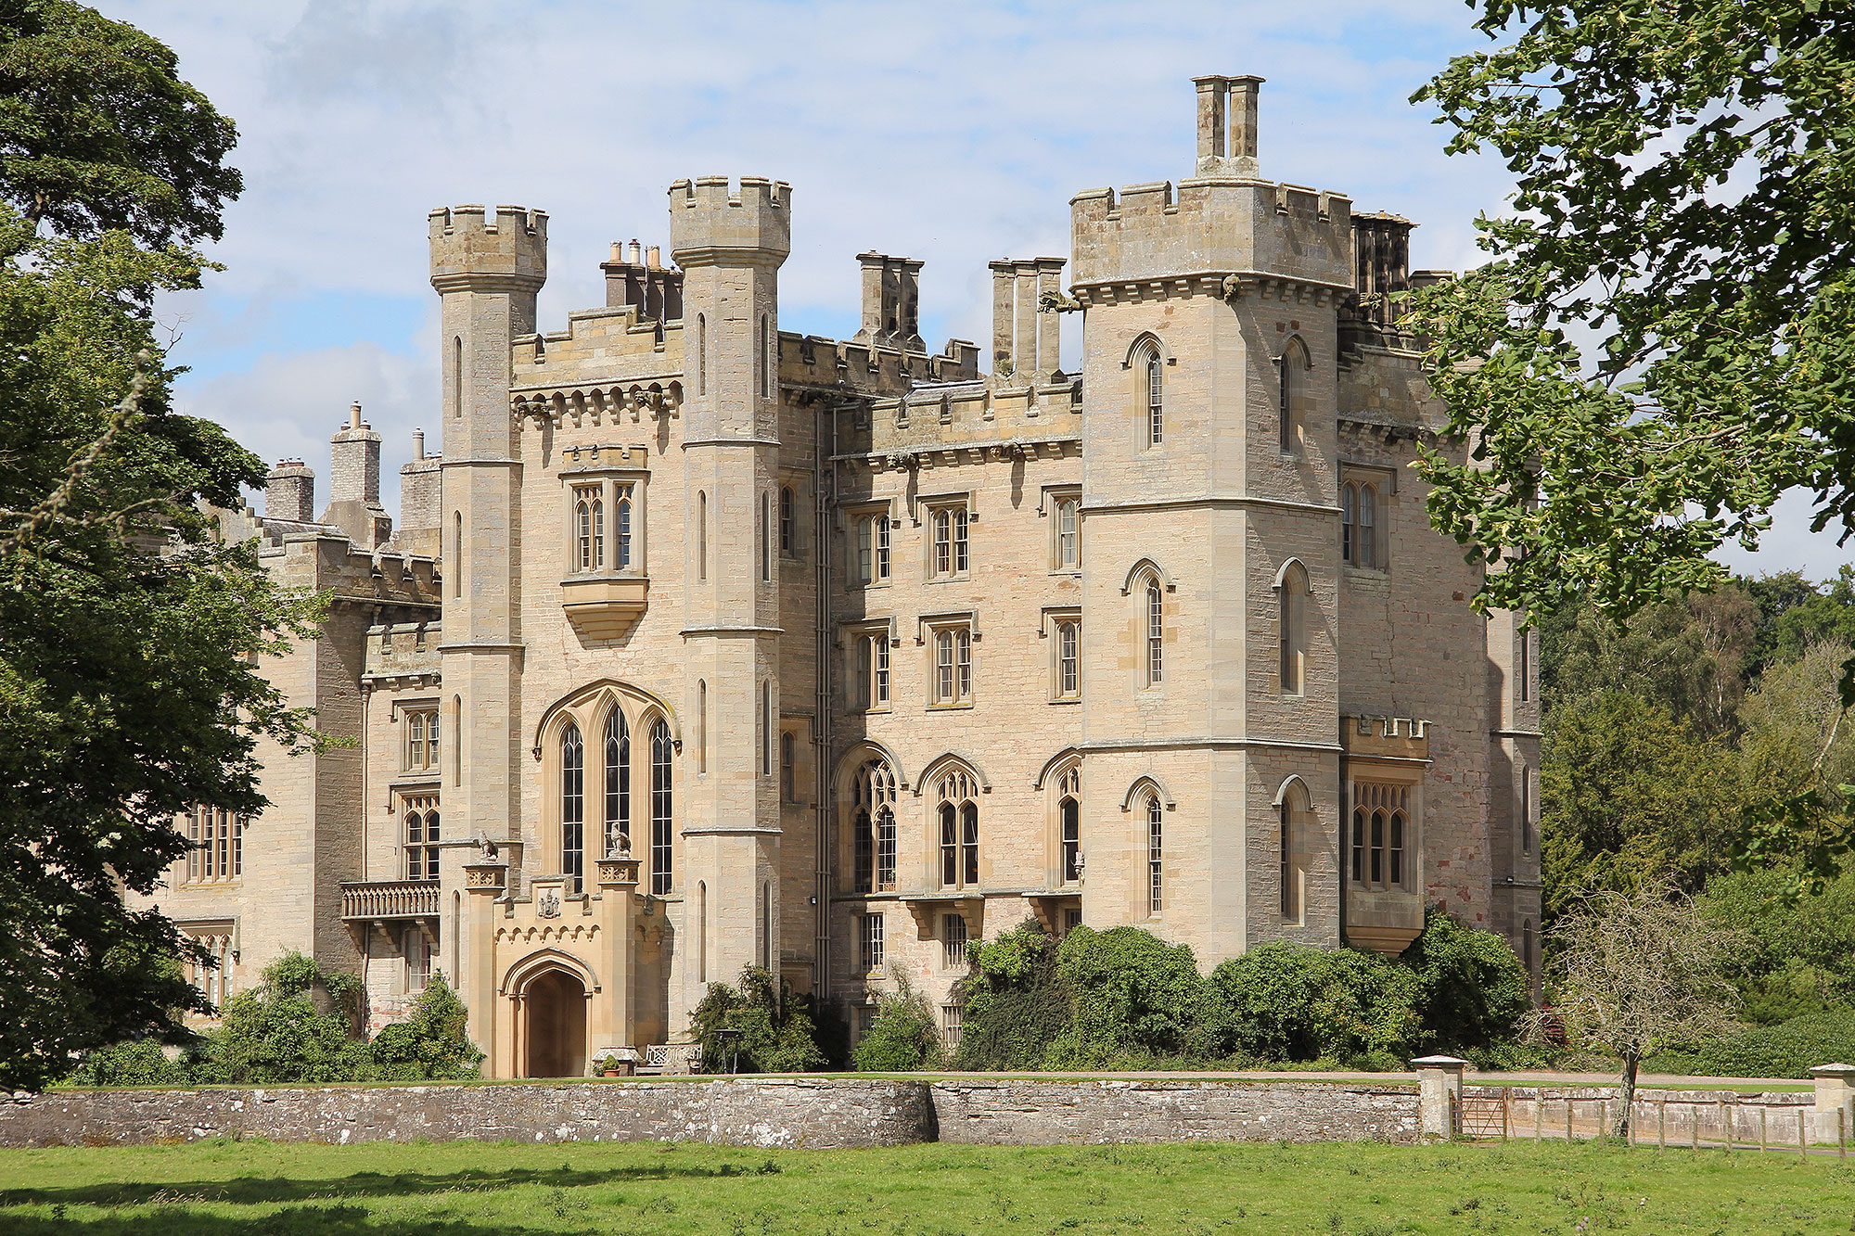
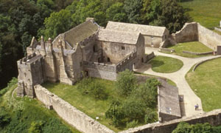
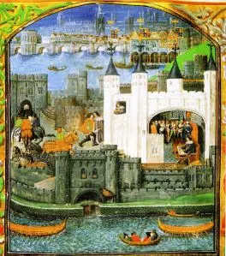
Used as a medieval manor/castle for over 1,000 years. The White Tower was built in the 1080’s by William the Conqueror
A unit of land consisting of a lord's large country house, usually including pasture, orchard, mill, wine press, blacksmith, etc. and lands rented to tenants.
A Medieval Manor:

Slide 19
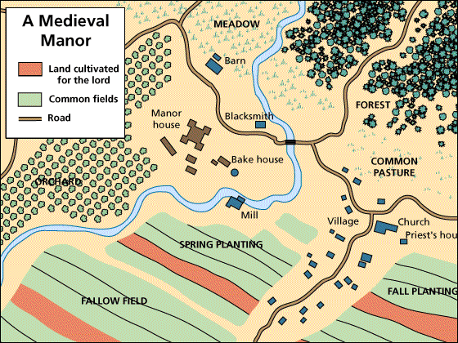
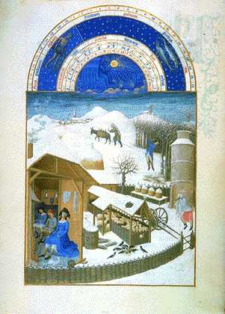
The peasant slowly became a serf –permanent member of lord’s labor force -tied to the land
Life on the Manor
The peasants (serfs) needed defense –surrendered themselves & portion of their crops to local lord.
In return, they received protection, use of the mill, wine press, tools, blacksmith, pasture, etc.

Slide 20
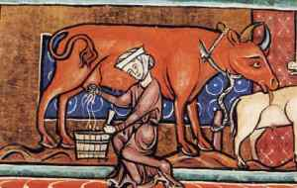
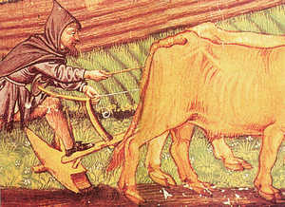
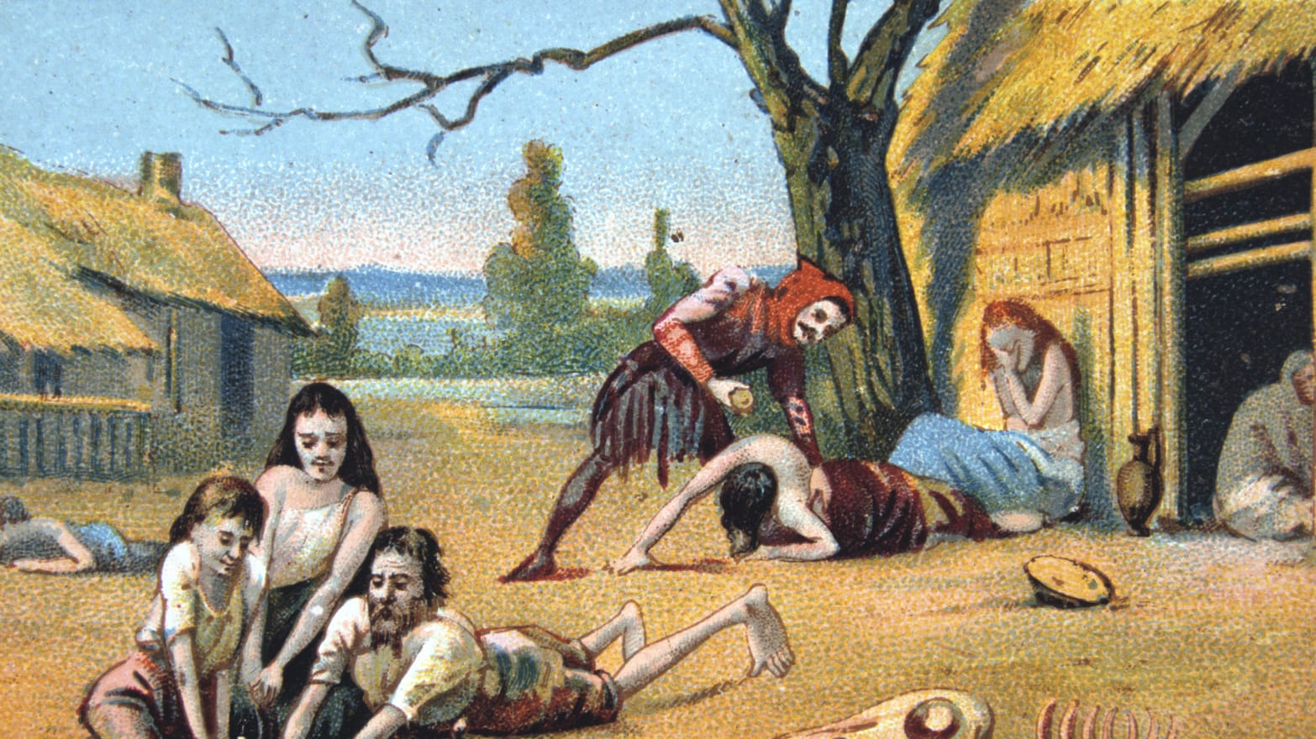
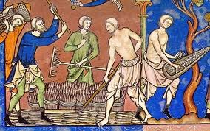
The Life of a Peasant:
A peasant’s life was very harsh
Men, women and children worked from sunrise until sundown. Backbreaking work; accidents were common
Hunger was constant - malnutrition would lead to poor health / weakness/ no energy

Slide 21
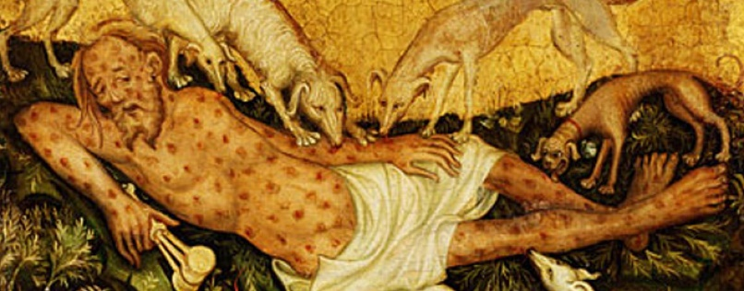
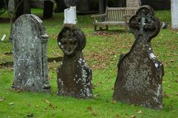
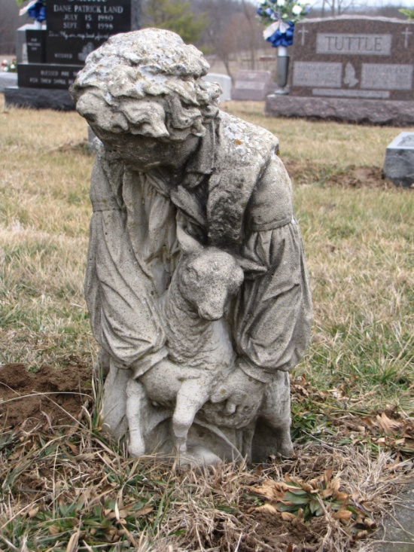
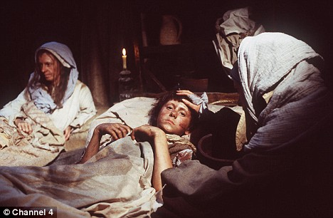
The Life of a Peasant:
A peasant’s life was very harsh
Disease took a heavy toll. No antibiotics or immunizations /smallpox, measles, mumps, anthrax, influenza, bubonic plague
Few peasants lived beyond age of 35. Most babies did not live to see their first birthday.

Slide 22
Peasants & serfs lived in simple cottages:
Made of wood, sticks, mud, some rock when available wattle and daub>>>>
Hard-packed dirt floors
Thatched roofs (tightly woven straw/ waterproof)
One or two rooms – with the livestock brought in at night
Open fire in the middle of the room – smoke rises through a hole in the roof – very smoky unhealthy air

Slide 24
*Staple of food for rich & poor was coarse brown bread.
*They would also eat hard cheeses, Root vegetables (carrots, turnips), cabbage, dried beans, peas, lentils, and barley as well as fruit in season.
*Meat was scarce for peasants, more common for the lords.
A bread trencher (bowl) with root vegetables
Pottage Stew of barley, cabbage, carrots & mushrooms along with coarse and crusty rye brown bread

Slide 25
The people of the Middle Ages often drank alcohal, and as water was often unclean, it was a necessity.
Alcoholic drinks, especially ale (beer), was a popular choice, having been boiled as part of the brewing process (which kills the germs.)
The poor (and rich alike) drank ale, mead (honey wine) or hard cider - and the rich were also able to drink many different types of wines.
Even children drank the watered-down ale or wine.

Slide 26
Peasants found occasions to celebrate such as marriages and births - There would be dancing and sports.
Breaks came at Christmas and Easter when peasants had from a few days to a week off from work.

Slide 27
Noblewomen in warrior society:
Most did not learn how to read.
A woman was expected to bear many children for her husband.
Most marriages were arranged, generally much younger women to older men who had property.

Slide 28
Noblewomen had many duties in warrior society:
advised vassals, managed the household, and took care of agricultural and medical tasks.
Women’s right to inheritance were restricted. When her husband died all the property frequently went to the son.

Slide 29
Women were still effectively the property of their husbands – but gained more freedom in the late Middle Ages:
Peasant women eventually began working with their husbands in business and trade

